Slide 1
Supporting niche formats and hardware in open source software and operating systems
Kieran Kunhya <kieran@kunhya.com> - @kierank_

Slide 2
Who am I?
Work on Open Source Multimedia in both a personal and professional capacity: FFmpeg and x264 in particular.
Also interested in reverse engineering of codecs and hardware
Presentation in reverse chronological order for ease of understanding
This presentation given in a personal capacity

Slide 3

Why FFmpeg?
De-facto open source multimedia processing tool and library
Many web browsers implement complex specifications like HTML and CSS
Nothing comparable in multimedia
Basis of video players such as VLC, browsers (Chrome + Firefox), Smart TVs etc
Written in C, not in newfangled language of the week
Widely supported across computer architectures
Likely tens of decades or more of support
Works on RPI, watch, other weird device

Slide 4
Standing on the Shoulders of Giants
Kostya Shishkov and Paul Mahol
Master codec reverse engineers
Willingness to teach and help (in their own special way…)
Both reverse engineered dozens of codecs
Monumental impact on media playback

Slide 5
Why support niche formats
Someday, someone might discover and want to play these formats.
An impact now or long into the future
Most of you in the room are that impact
Quite a lot of multimedia low-hanging fruit is “done”, good way to stay familiar with concepts (entropy coding, DCT).
Something you can do over Easter/Christmas.
Also work for new students

Slide 6
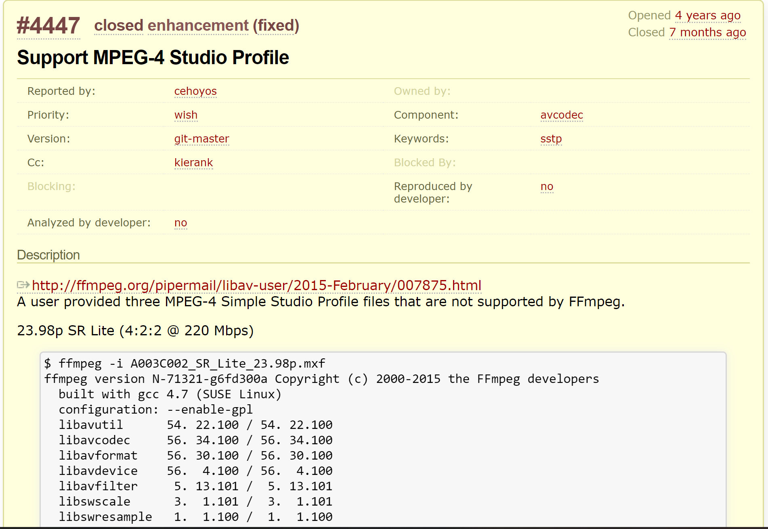
This ticket
There are so many variants of MPEG-4, why are these ones not supported?
Why are they 4:2:2 and 4:4:4?
Only 3 samples available, to this day no real-world samples found.

Slide 7
MPEG-4 Sstp (1)
Spent a lot of time trawling the internet looking for recent copy of paid spec
Common in industry but a big problem for independent developers.
Eventually found it on some Chinese website
Woah this is different
Up to 12-bit data, 4:2:2, 4:4:4, RGB – none supported in existing MPEG-4 code
> 16-bit coefficients (not supported in FFmpeg IDCT)
Crazy DPCM mode with vertical block scanning
Only one program on Windows, no ability to extract raw data

Slide 8
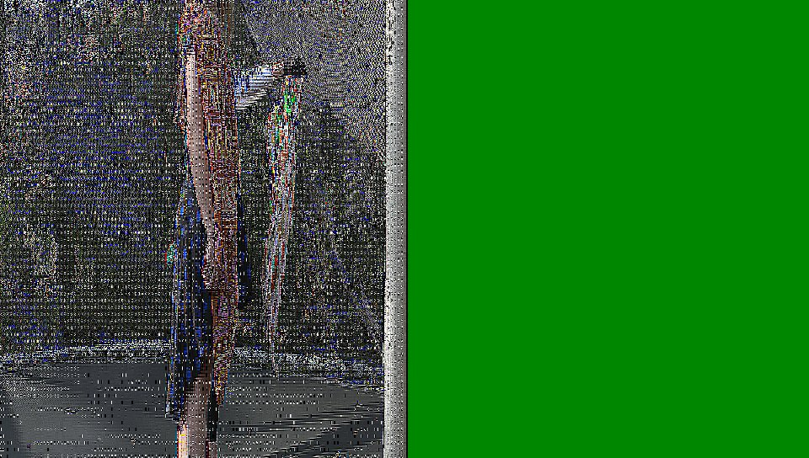
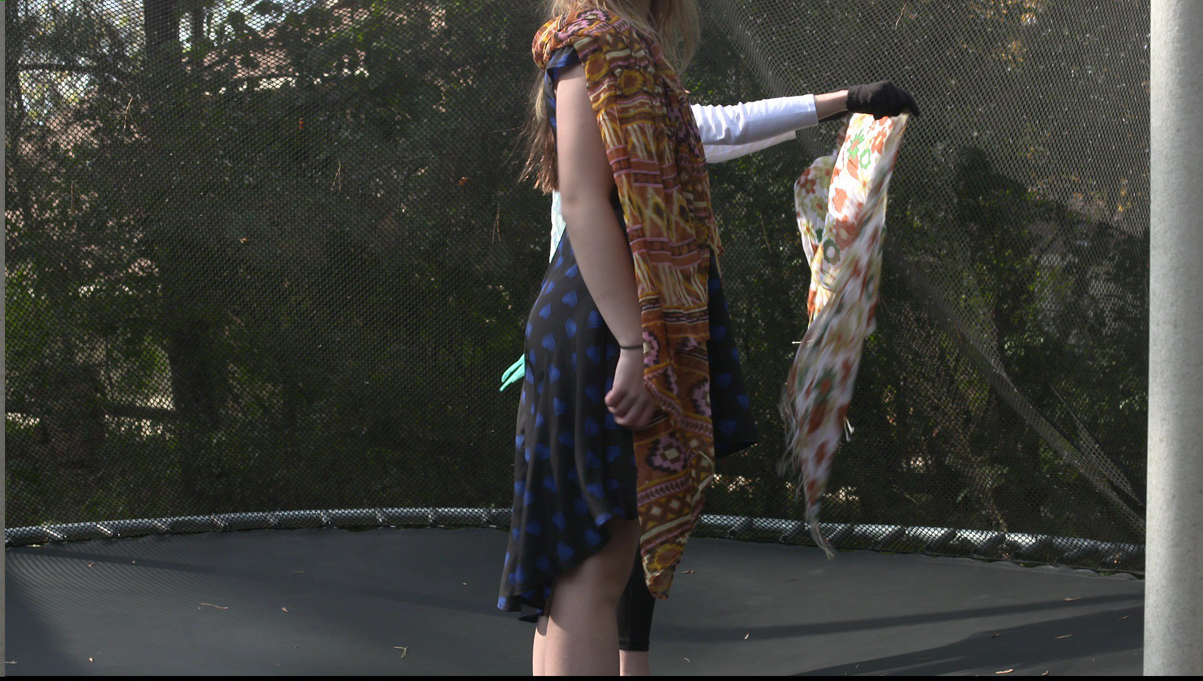
MPEG-4 Sstp (2)
Entropy coding nice, either works or it doesn’t
Used float IDCT to get to working picture
No reference decoder, tweaked picture until it looked ok.
Took another year to get round to boring work of implementing templated integer IDCT.
Also tedious work to hack-in 10/12-bit into FFmpeg, not ideal method.

Slide 9
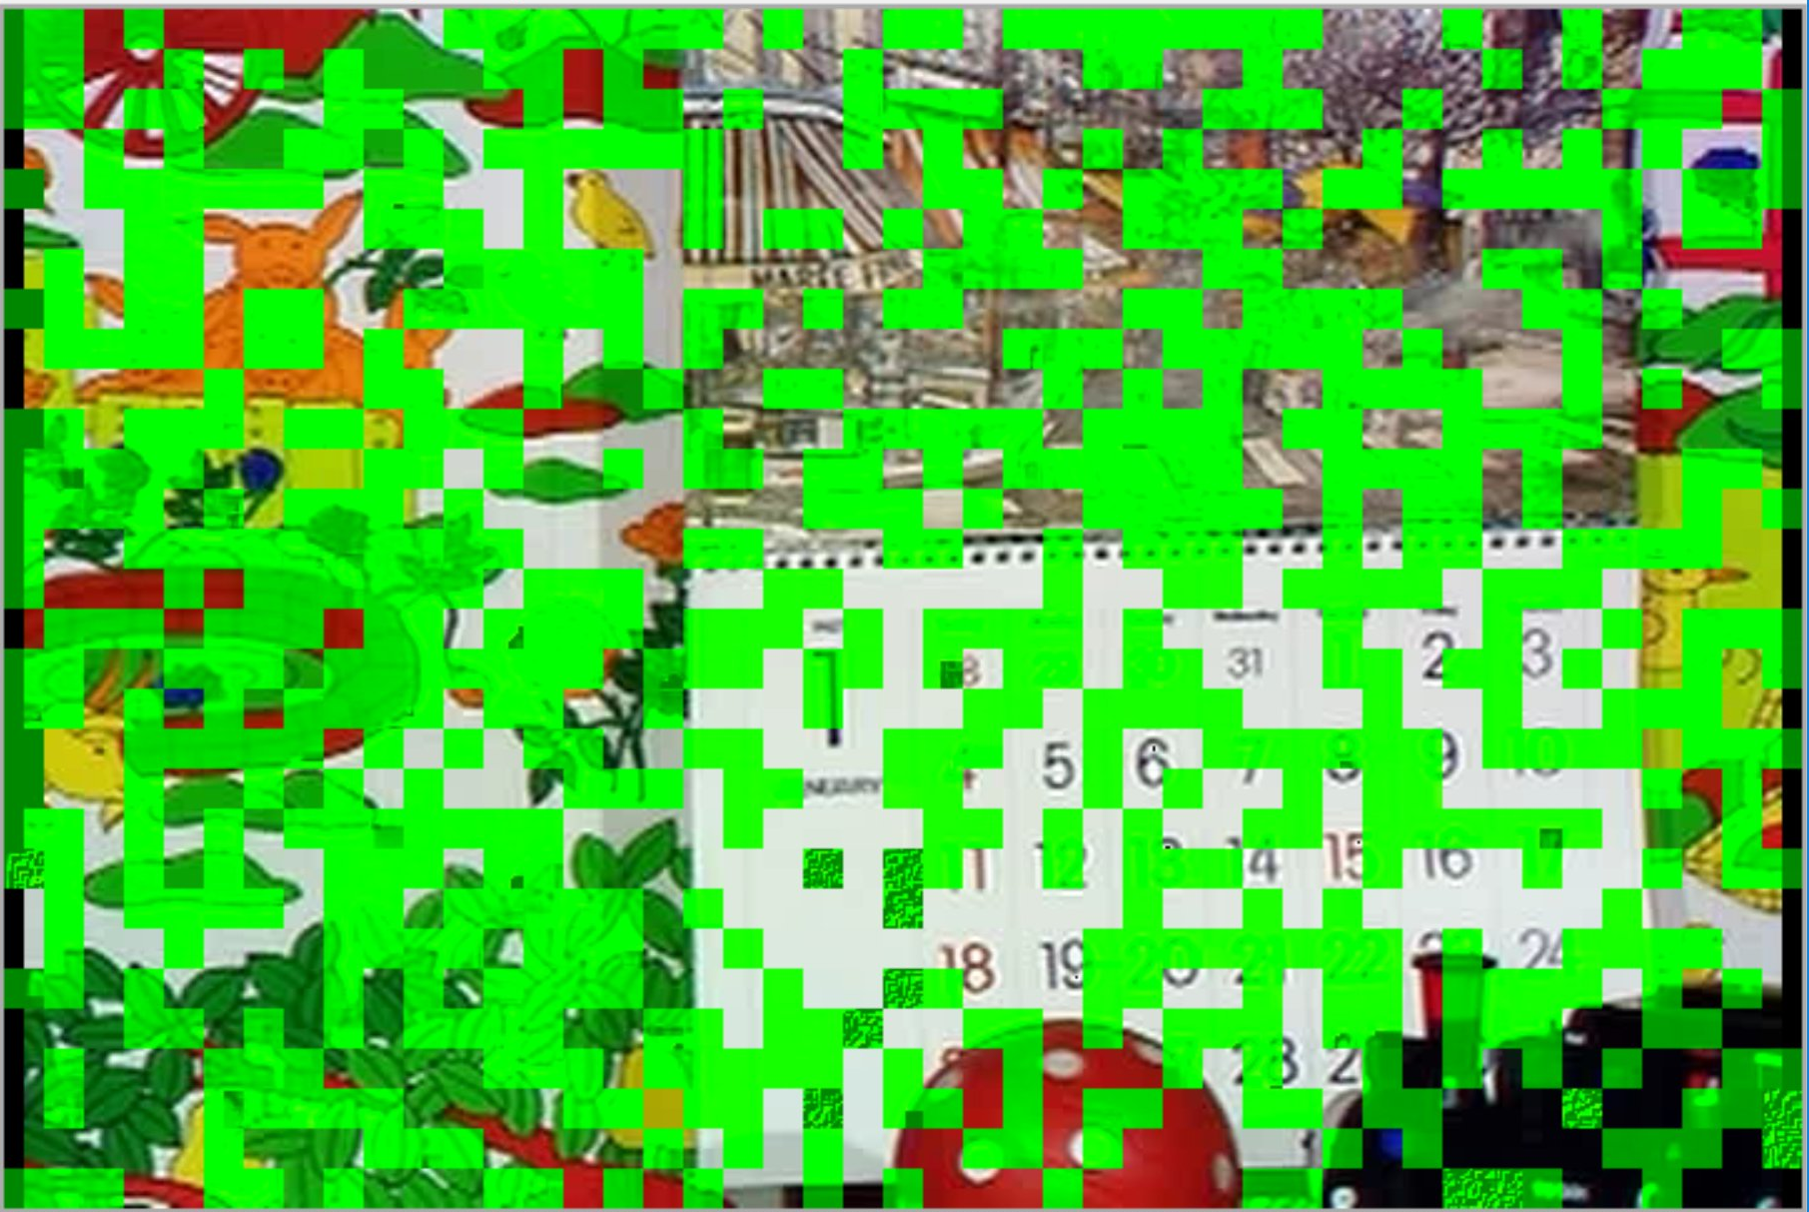
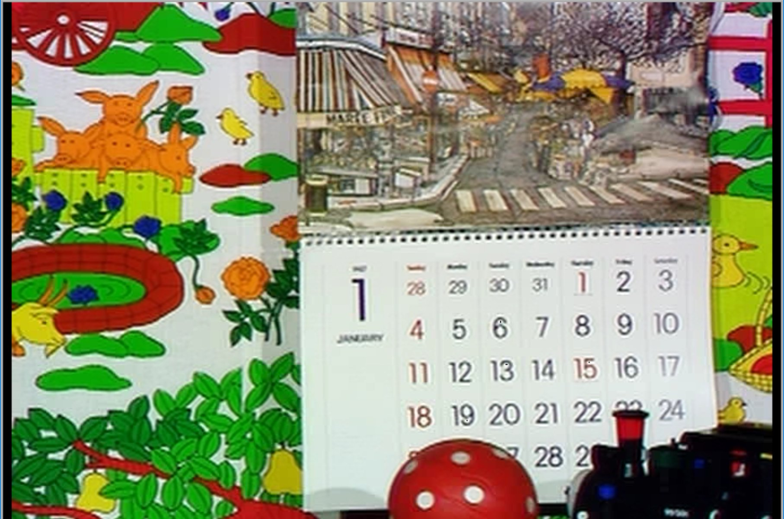
MPEG-4 Sstp (3)
Was quite hard to verify DPCM blocks
After a lot of digging online found conformance MPEG bitstreams, weird raw file format.
Got to position where nearly all of image worked but some part looked weird.
After even more digging found reference software. Typo found: -(x >> n) != ((-x) >> n)
Might be some minor errors, probably IDCT precision problem, maybe > 32-bit intermediates?

Slide 10
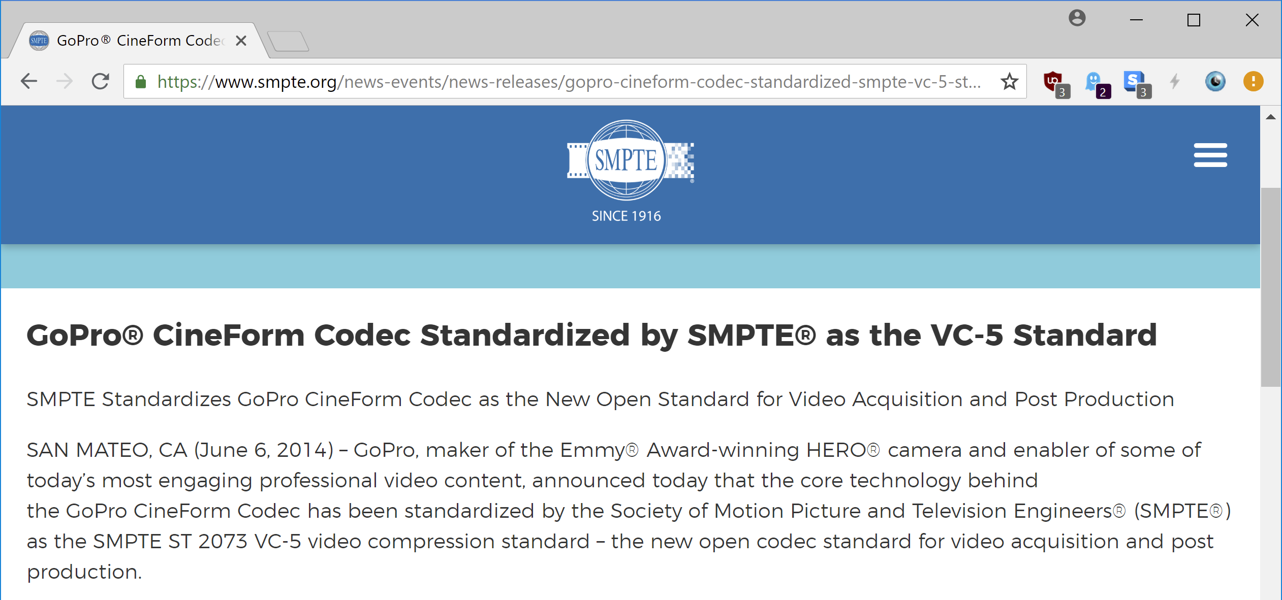
This press release

Slide 11
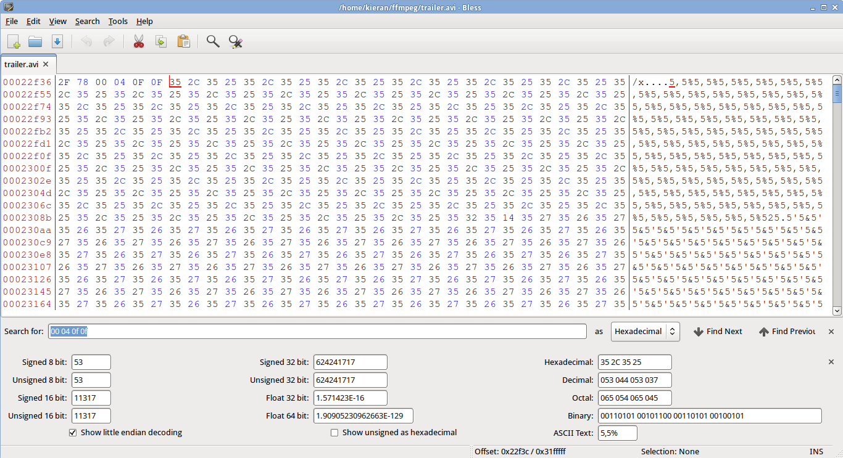
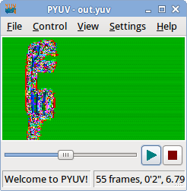
Cineform
Downloaded SMPTE VC-5 specification
Some things similar but some things in real world completely different
Hints that lowpass coefficients were raw, by luck one sample had quite a lot of flat colours.
Helped identify region
Lucky also this sample used the published codebook, though could have reverse engineered from binary decoder

Slide 12
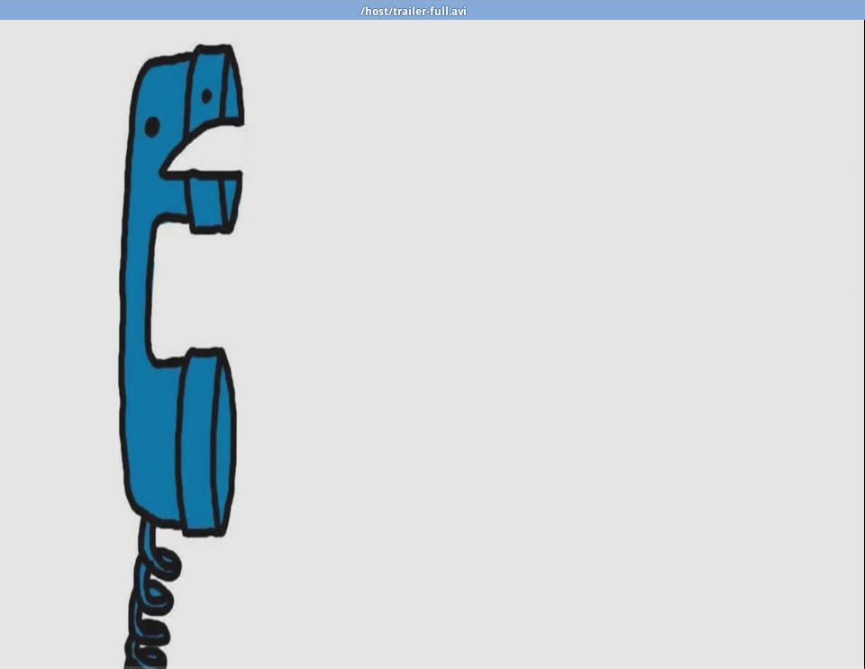
Cineform (2)
Continue reverse engineering tags, lots of people contributed samples.
Aligned coefficient layout
Simple and fast codec
Eventually get to working decoder
Some samples had more complicated structures, “3D-transform” frames, interlaced, bayer.

Slide 13
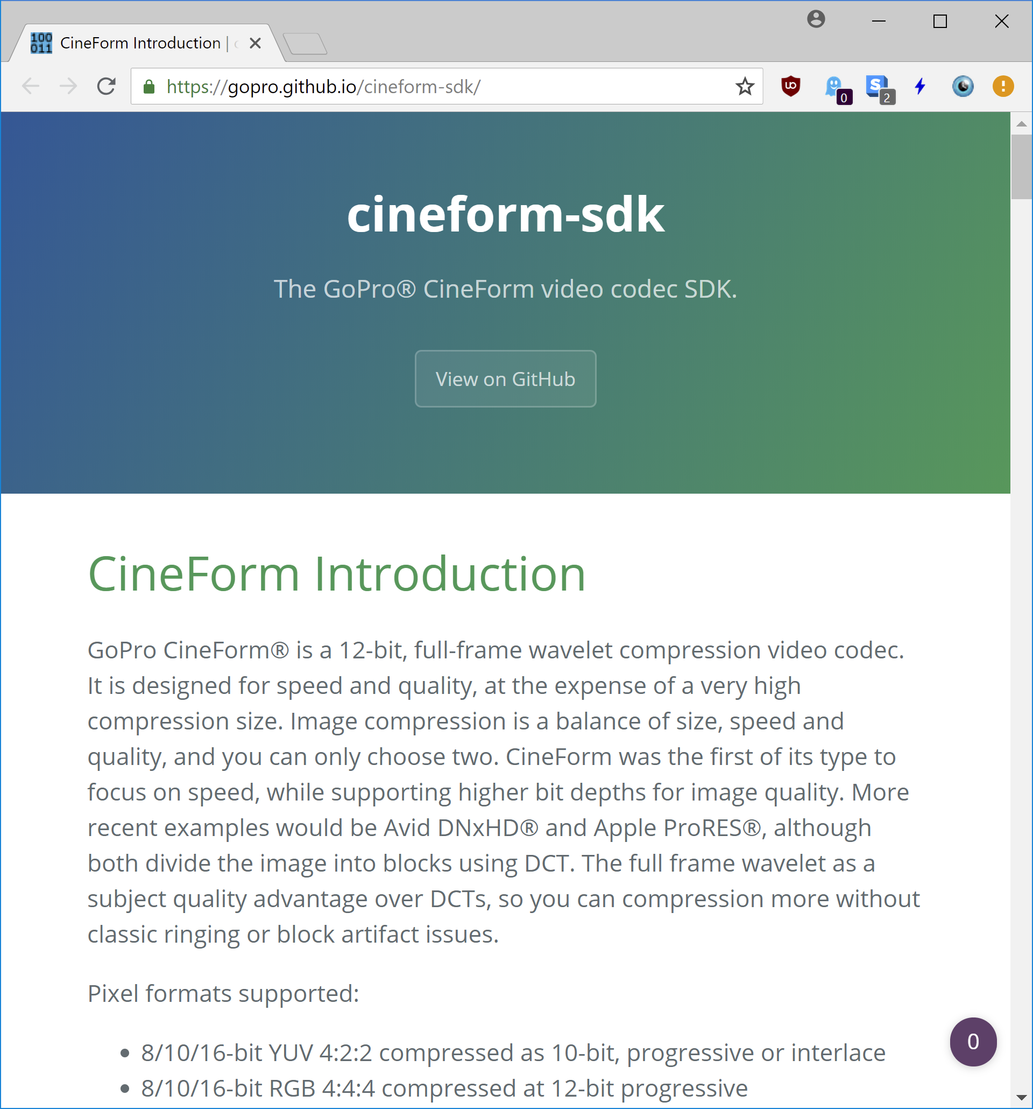
Cineform (3)
https://medium.com/@kierank_/reverse-engineering-the-gopro-cineform-codec-7411312bfe1c – 36k readers!
Eventually led to Cineform being open-sourced by GoPro!
Few missing pieces implemented by Google Summer of Code 2018 student
Not integrated into FFmpeg yet

Slide 14
But what about Physical Media files come on
One day someone will come across these and wonder how to read files
Panasonic P2 and Sony SxS cards
PCI and PCI Express-based respectively
Both common and widely used, precursors to modern NVMe storage
Closed source Windows and Mac drivers, or proprietary readers.
Likely won’t work in 100 years
Linux driver will last, nothing comparable hardware support

Slide 15
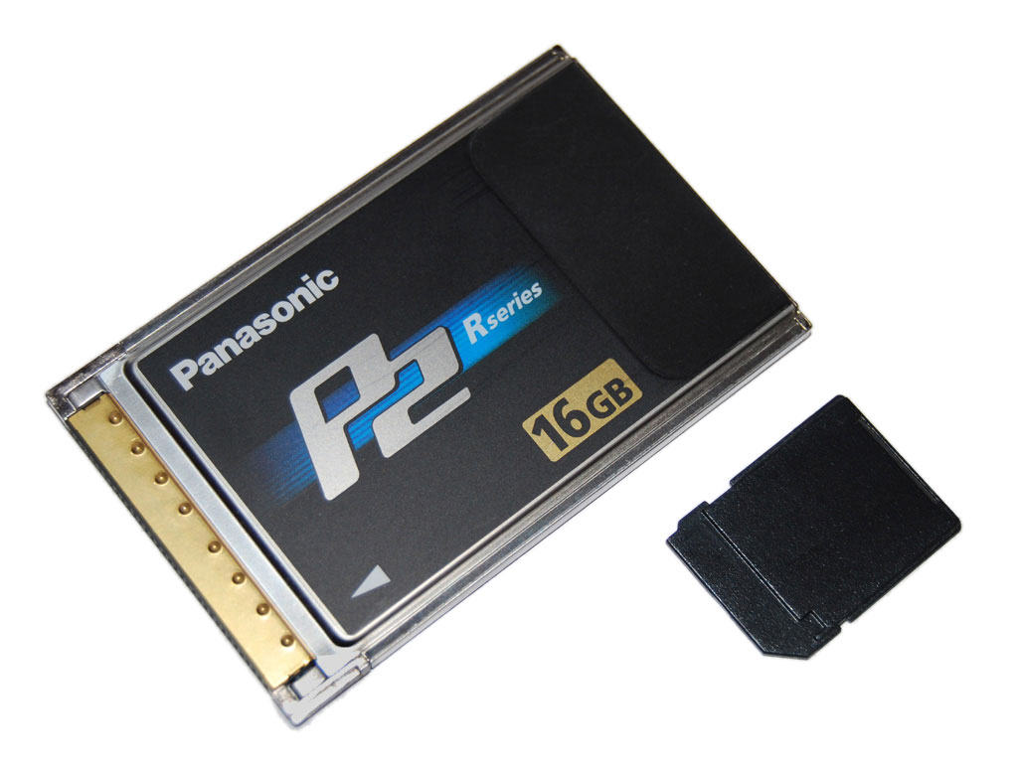
Panasonic P2 (1)
PCMCIA based solid stage storage introduced in 2004
Modern PCI Express backwards compatible with legacy PCI
Bought cheap card off eBay.

Slide 16
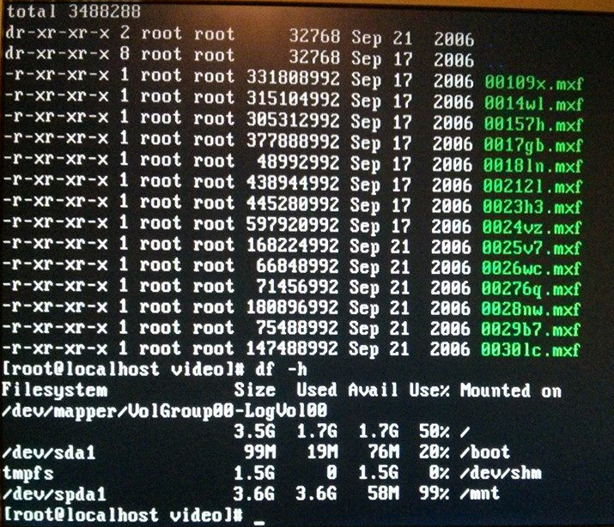
Panasonic P2 (2)
Request source code for Linux on camera
Dig through thousands of lines and find ancient Linux 2.4 driver.
Go to parents house, find my high school PC from 2008 with legacy PCI slot.
Will it work without official hardware?
A lot of messing with CentOS and wow, it worked!
Might have newer cameras with more reasonable driver:
https://github.com/kierank/p2card

Slide 17
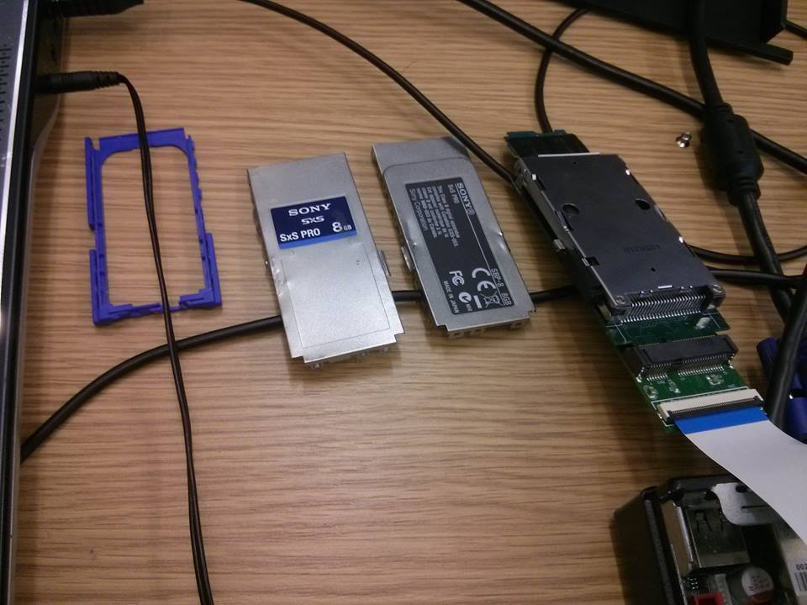
Sony SxS
Also requested source code, no driver to be found ☹
Instead looked into reverse engineering.
Built rig to easily use card.
Setup Windows XP QEMU to sniff memory mapped IO, how the driver is reading memory from the card.
https://hakzsam.wordpress.com/2015/02/21/471/

Slide 18
Sony SxS (2)
At the time needed newest CPU with IOMMU
Use “dd” to read block by block and see how the driver reads and writes. Change the block index, and continue
Very basic by modern NVMe standards
Request block, get an interrupt with buffer
https://github.com/kierank/sxs-linux
No working DMA yet so very slow
Need time to get it into mainline Linux (Christmas?)

Slide 19
Conclusions
Audio and Video codec reverse engineering is tending to completion
Codecs are being reverse engineered at a faster rate than they are created
This has remarkable historical consequences for media
Both the fact that users can “store” their content on sites like YouTube
Or that discovered media will be playable for decades
That said there are still many proprietary storage formats out there
May not be easily possible to use commodity reader and reverse engineer

